Slide 1

Elektronika dan Instrumentasi:
Elektronika Digital 3 –
Enkoder, Dekoder, 7 segment
Dari
Dimas Firmanda Al Riza

Slide 2
Dekoder dan Enkoder
BINARY CODE INPUT
ONLY ONE INPUT ACTIVATED AT A TIME
ONLY ONE OUTPUT ACTIVATED AT A TIME
BINARY CODE OUTPUT

Slide 3
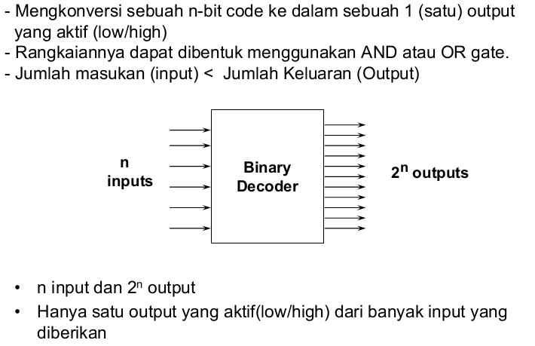
Binary Dekoding
Dekoder adalah suatu rangkaian logika yang memiliki sedikit masukan dan banyak keluaran.

Slide 4
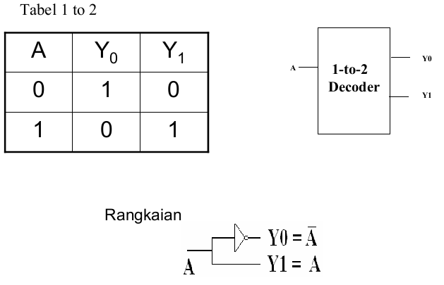
1 to 2 Dekoder

Slide 5
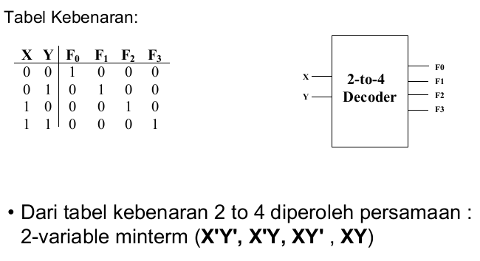
2 to 4 Dekoder

Slide 6
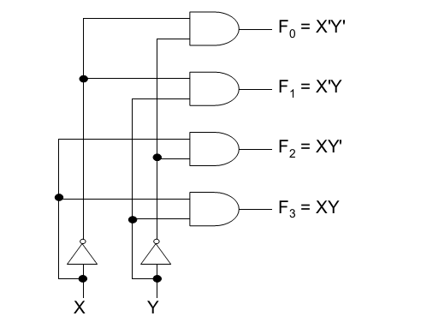
Rangkaian 2 to 4 Dekoder

Slide 7
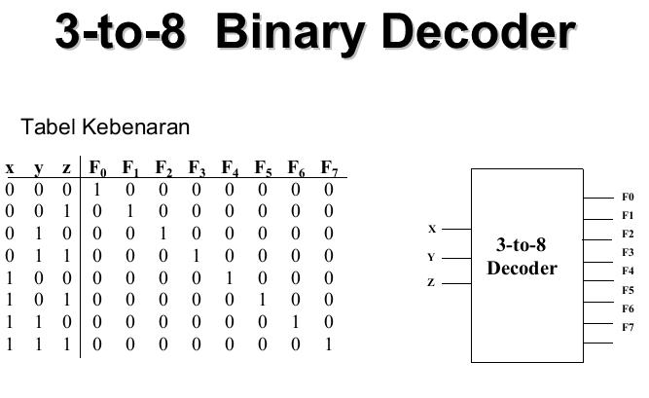
3 to 8 Dekoder

Slide 8
3 to 8 Dekoder

Slide 9
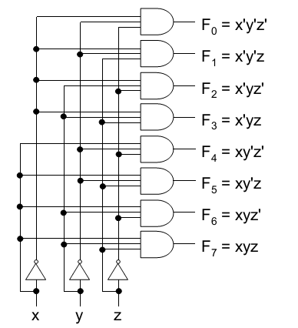
Rangkaian 3 to 8 Dekoder

Slide 10
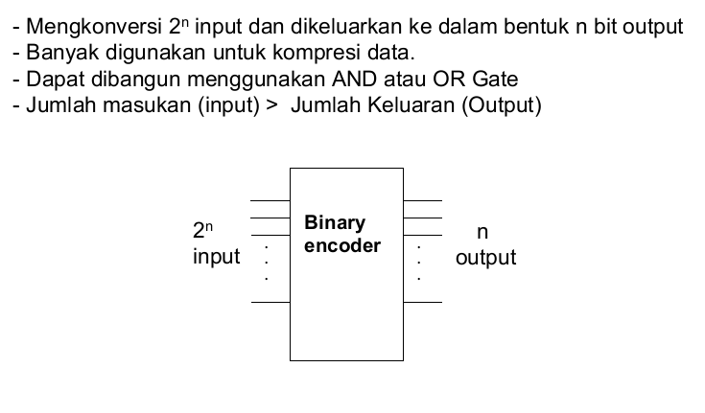
Enkoder Binary

Slide 11
ELECTRONIC ENCODER - DECIMAL TO BCD
BCD output
Decimal input
0 0 0 0
0 1 0 1
0 1 1 1
0 0 1 1
7
Decimal
to
BCD
Encoder
5
3
0
Encoders are available in IC form.
This encoder translates from decimal input to BCD output.

Slide 12
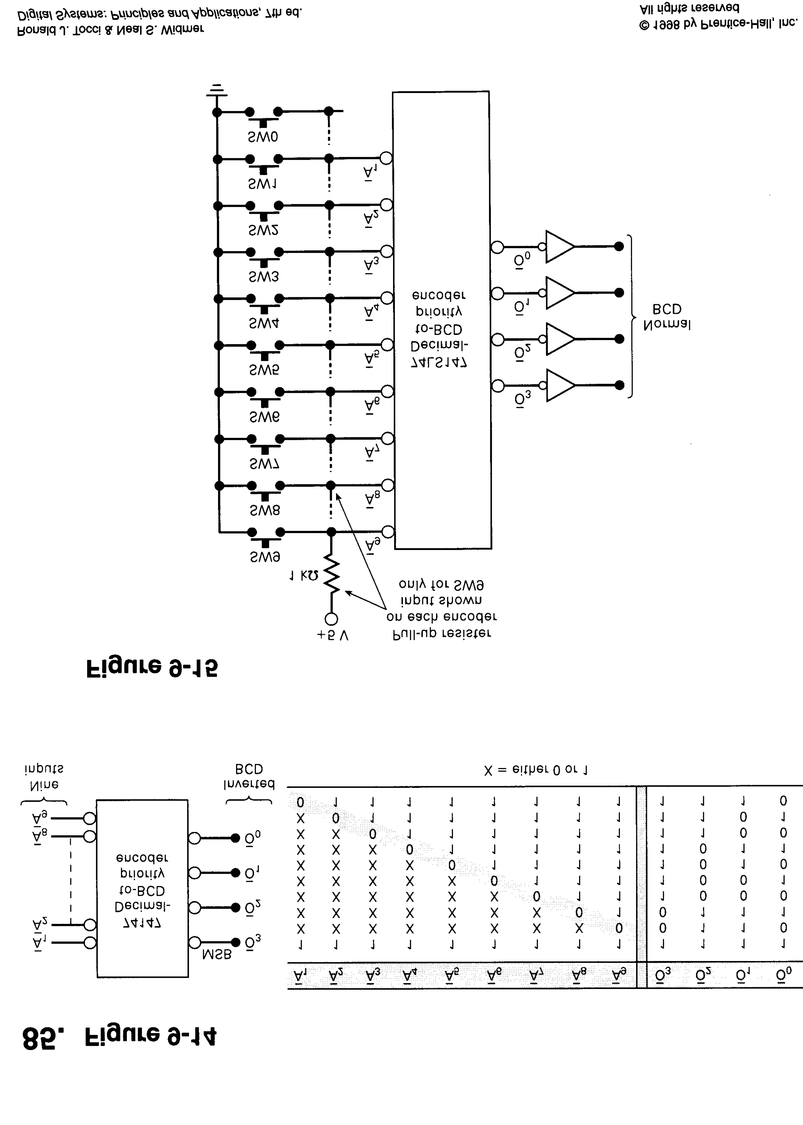
10 line to 4 line Encoder

Slide 13
10 line to 4 line Encoder

Slide 14
4 line to 10 line Decoder

Slide 15
DECODERS: BCD TO 7-SEGMENT DECODER/DRIVER
BCD input
Decimal output
LED
0 0 0 0
0 0 0 1
0 0 1 0
0 0 1 1
0 1 0 0
BCD-to-
7-Segment
Decoder/
Driver
Electronic decoders are available in IC form.
This decoder translates from BCD to decimal.
Decimals are shown on an 7-segment LED display.
This IC also drives the 7-segment LED display.

Slide 16
TEST
Q #1- What is the decimal output from the decoder that
appears on the 7-segment display?
Q #2- What is the decimal output from the decoder that
appears on the 7-segment display?
Q #3- What is the decimal output from the decoder that
appears on the 7-segment display?
Q #4- What is the decimal output from the decoder that
appears on the 7-segment display?
Q #5- What is the decimal output from the decoder that
appears on the 7-segment display?
Answer: 3
Answer: 0
Answer: 9
Answer: 7
Answer: 6
BCD input
Decimal output
1 0 0 1
0 1 1 1
0 0 0 0
0 1 1 0
0 0 1 1
BCD-to-
7-Segment
Decoder/
Driver
?

Slide 17
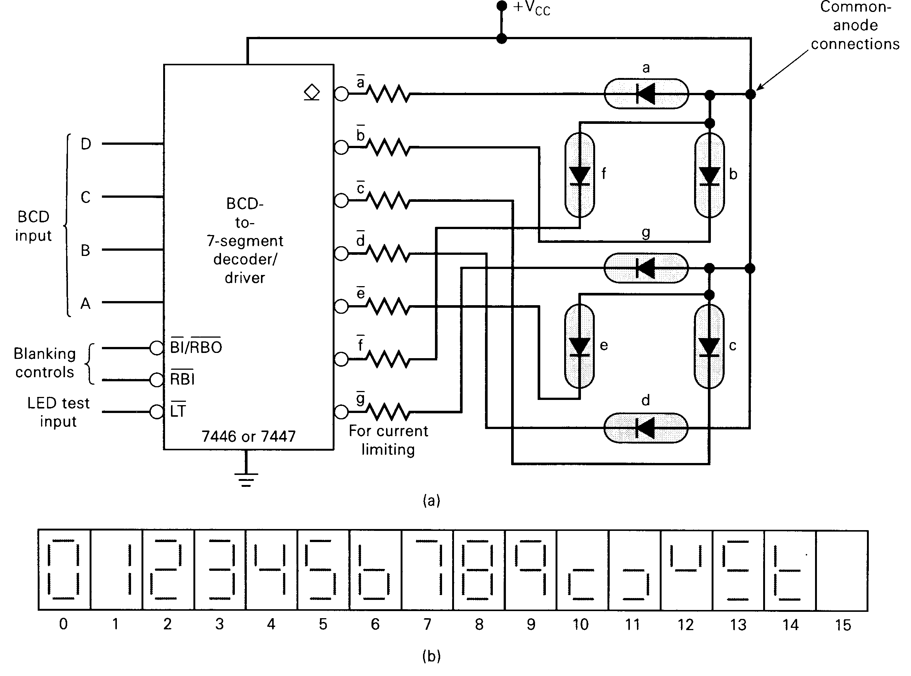

Slide 19
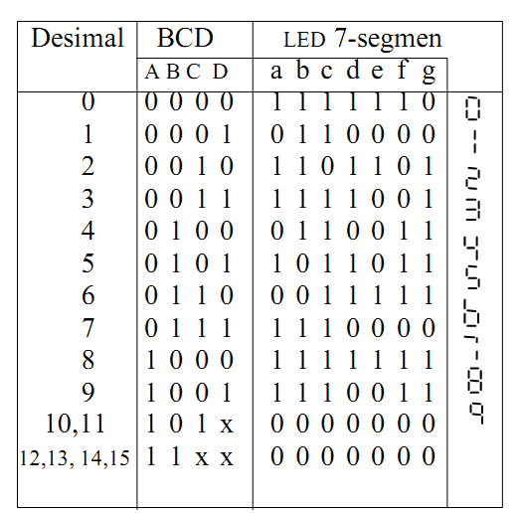
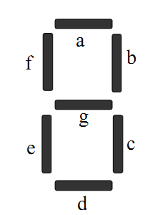
7-segmen display

Slide 20
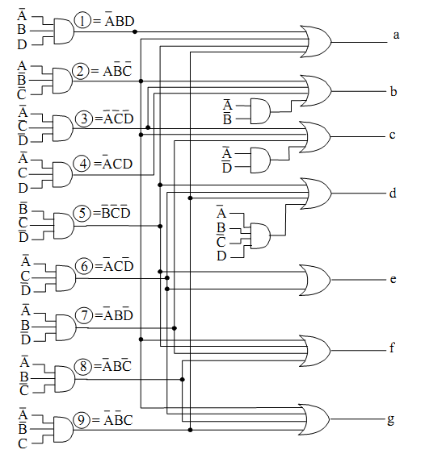
Rangkaian Pengubah kode BCD ke LED 7-segmen

Slide 21

Thankyou

